Slide 1
OBJECT ORIENTED
PROGRAMMING
Spring 2024
Miss Ayesha Majid

Slide 2
LECTURE – 4 - 5

Slide 3
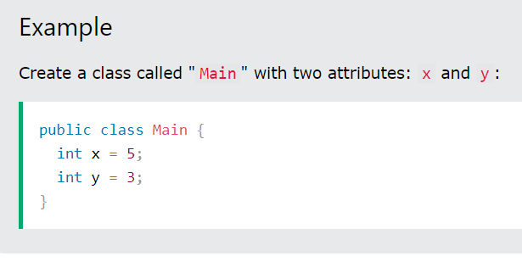
Java Class Attributes
In the previous chapter, we used the term "variable" for x in the example (as shown below). It is actually an attribute of the class. Or you could say that class attributes are variables within a class:
Another term for class attributes is fields.

Slide 4
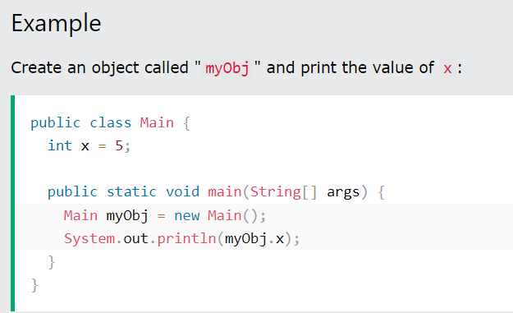
Accessing Attributes
You can access attributes by creating an object of the class, and by using the dot syntax (.):
The following example will create an object of the Main class, with the name myObj. We use the x attribute on the object to print its value:

Slide 5
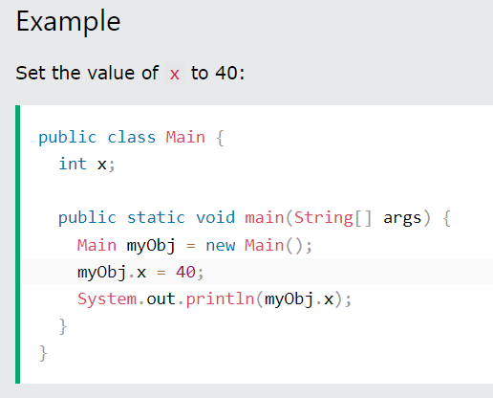
Modify Attributes
You can also modify attribute values:

Slide 6
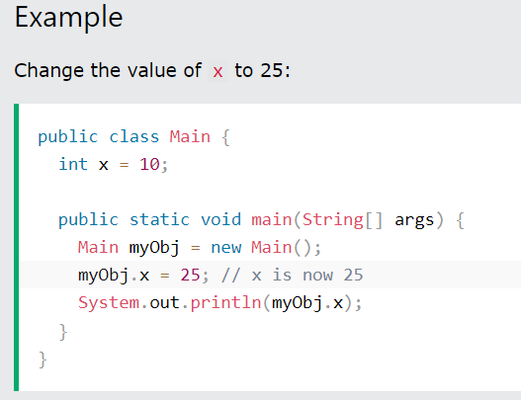
Or override existing values:

Slide 7
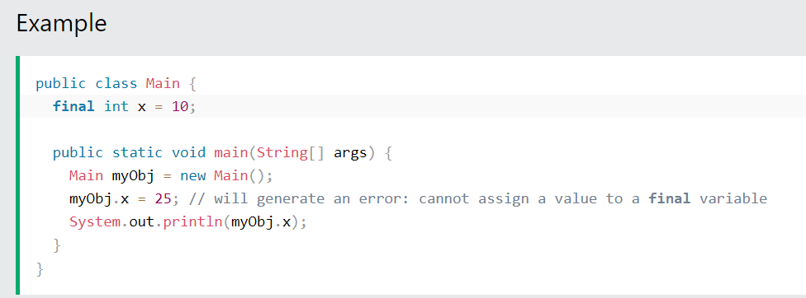
If you don't want the ability to override existing values, declare the attribute as final:
The final keyword is useful when you want a variable to always store the same value, like PI (3.14159...).
The final keyword is called a "modifier"

Slide 8
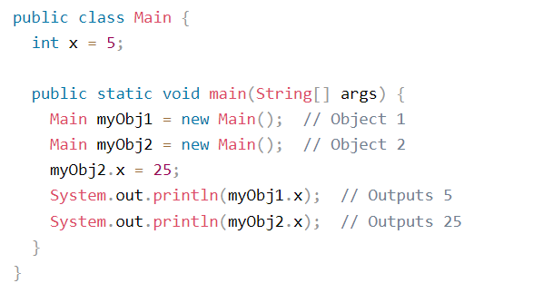
Multiple Objects
If you create multiple objects of one class, you can change the attribute values in one object, without affecting the attribute values in the other:
Example: Change the value of x to 25 in myObj2, and leave x in myObj1 unchanged:

Slide 9
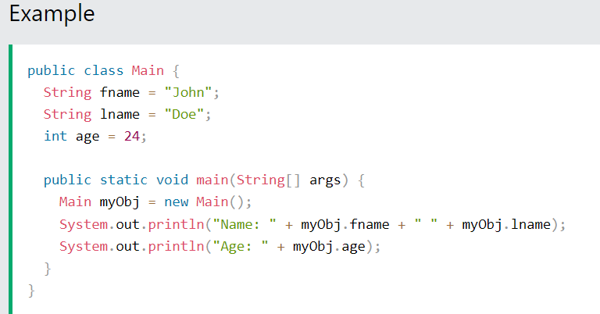
Multiple Attributes
You can specify as many attributes as you want:

Slide 10
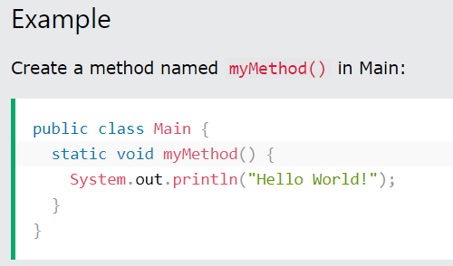
Java Class Methods
You learned from the Java Methods chapter that methods are declared within a class, and that they are used to perform certain actions
myMethod() prints a text (the action), when it is called. To call a method, write the method's name followed by two parentheses () and a semicolon;

Slide 11
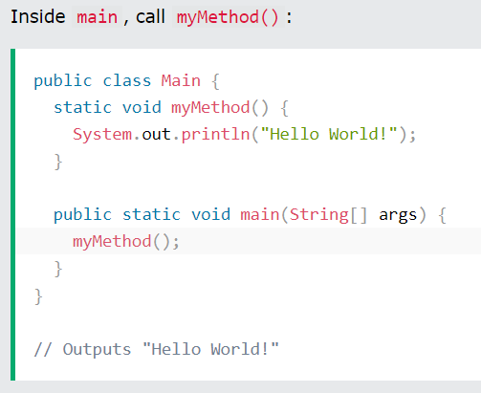
Example

Slide 12
Static vs. Public
You will often see Java programs that have either static or public attributes and methods.
In the example above, we created a static method, which means that it can be accessed without creating an object of the class, unlike public, which can only be accessed by objects:

Slide 13
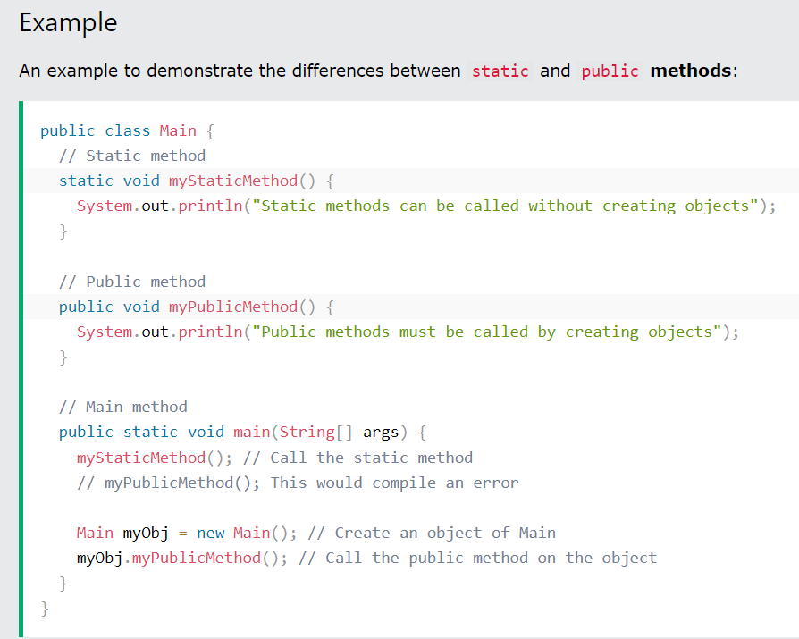
Example:

Slide 14
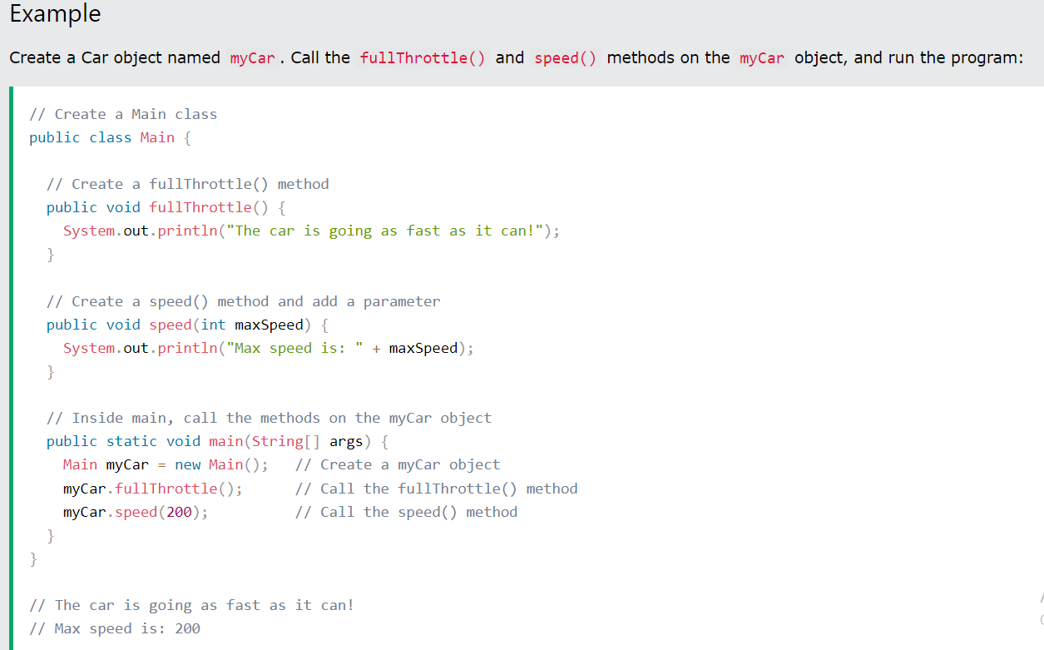
Access Methods With an Object

Slide 15
Using Multiple Classes
Like we specified in the Classes chapter, it is a good practice to create an object of a class and access it in another class.
Remember that the name of the java file should match the class name. In this example, we have created two files in the same directory:
Main.java
Second.java

Slide 16
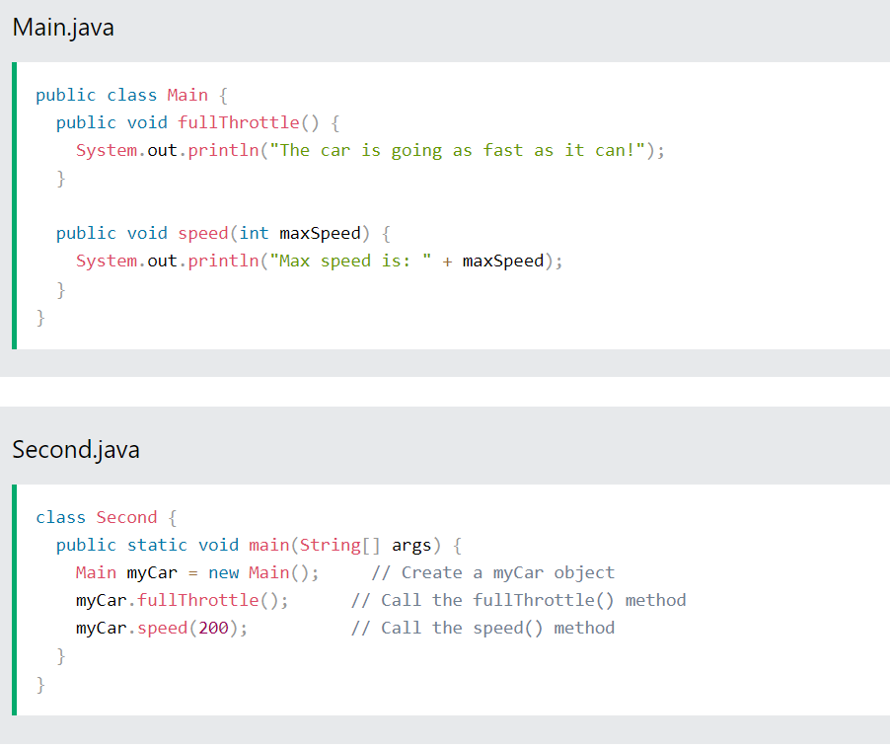

Slide 17
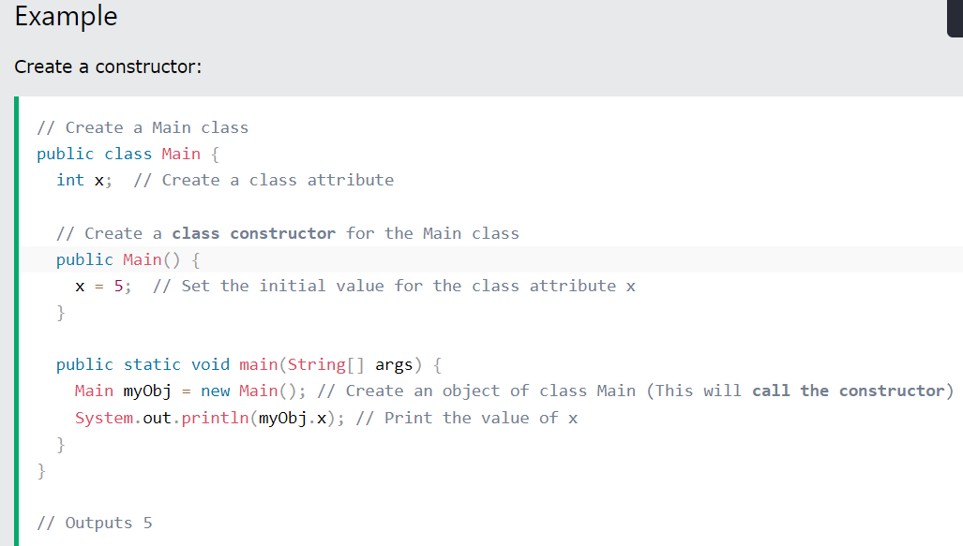
Java Constructors
A constructor in Java is a special method that is used to initialize objects. The constructor is called when an object of a class is created. It can be used to set initial values for object attributes:

Slide 18
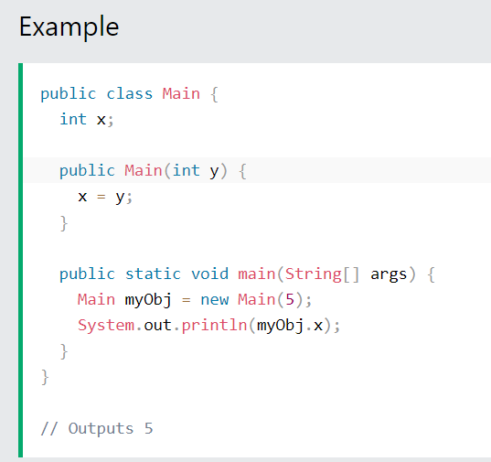
Constructor Parameters
Constructors can also take parameters, which is used to initialize attributes.
The following example adds an int y parameter to the constructor. Inside the constructor we set x to y (x=y). When we call the constructor, we pass a parameter to the constructor (5), which will set the value of x to 5:

Slide 19
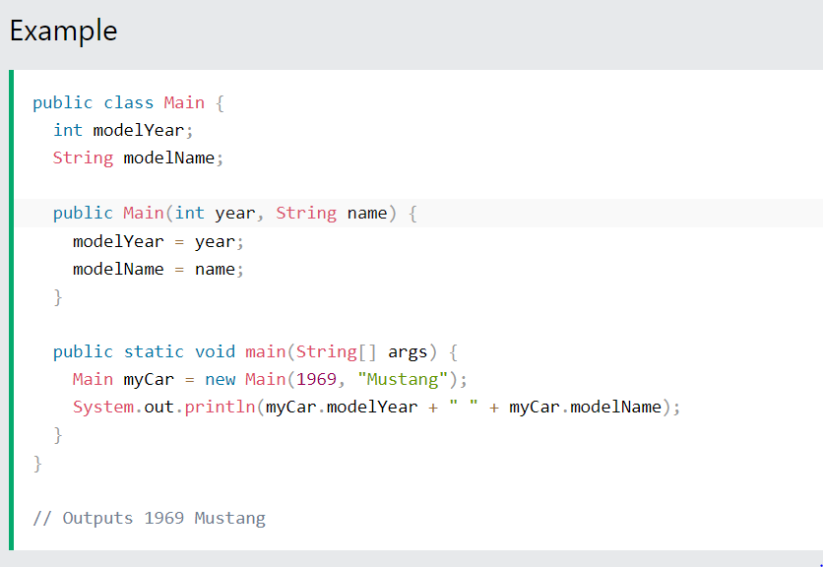
You can have as many parameters as you want:

Slide 20
Java Modifiers
The public keyword is an access modifier, meaning that it is used to set the access level for classes, attributes, methods and constructors.
We divide modifiers into two groups:
Access Modifiers - controls the access level
Non-Access Modifiers - do not control access level, but provides other functionality

Slide 21
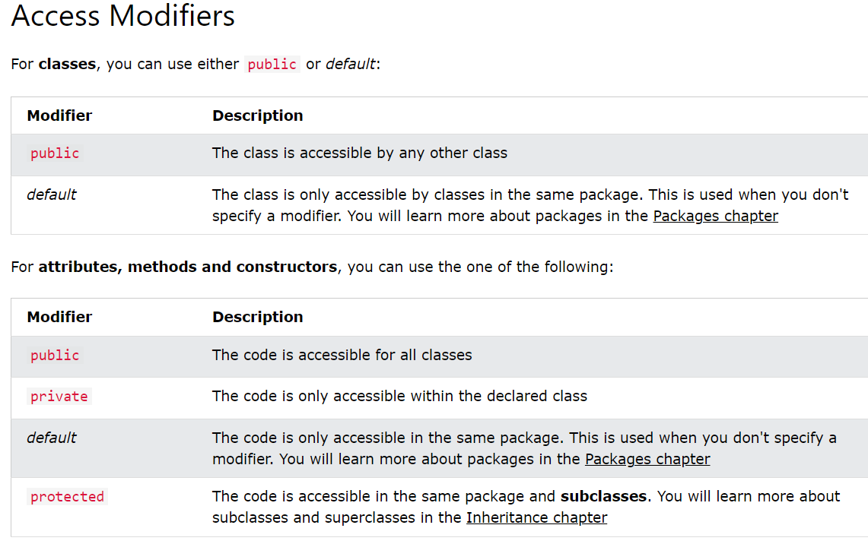

Slide 22
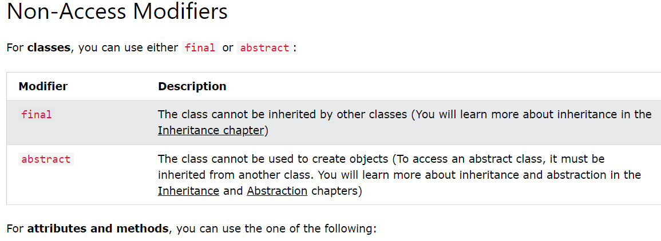

Slide 23
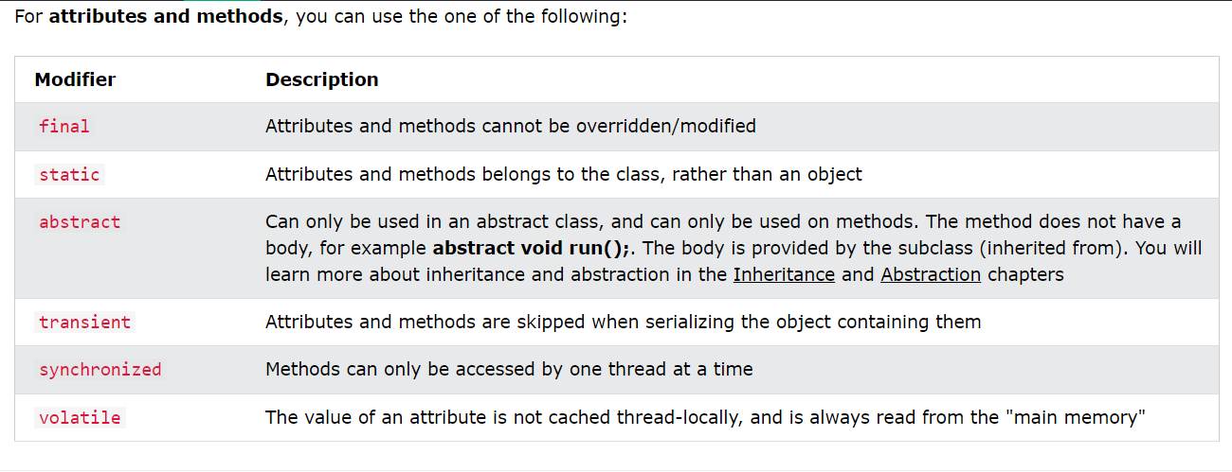

Slide 24
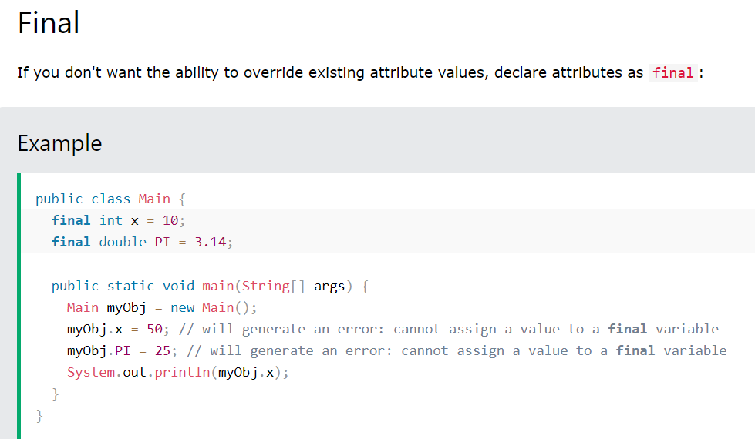

Slide 25
Static
A static method means that it can be accessed without creating an object of the class, unlike public:

Slide 26
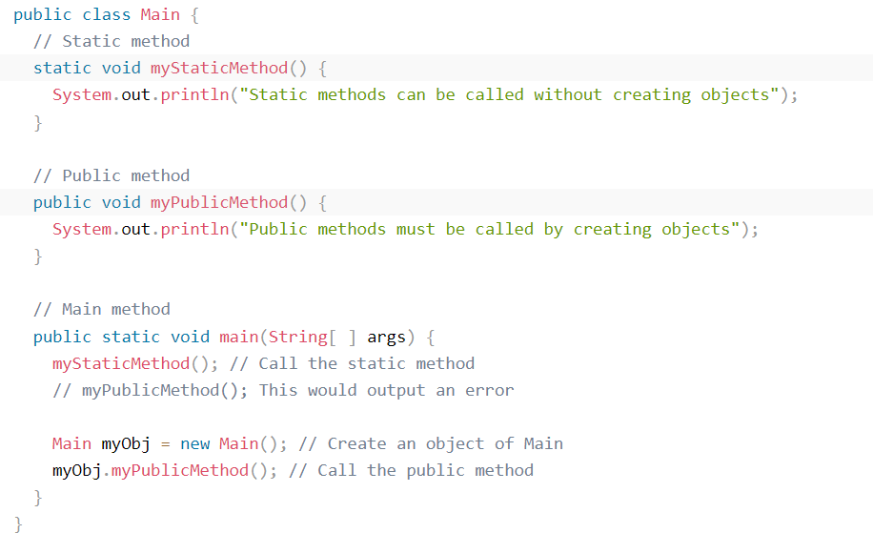
Example
An example to demonstrate the differences between static and public methods:

Slide 27
Abstract
An abstract method belongs to an abstract class, and it does not have a body. The body is provided by the subclass:

Slide 28
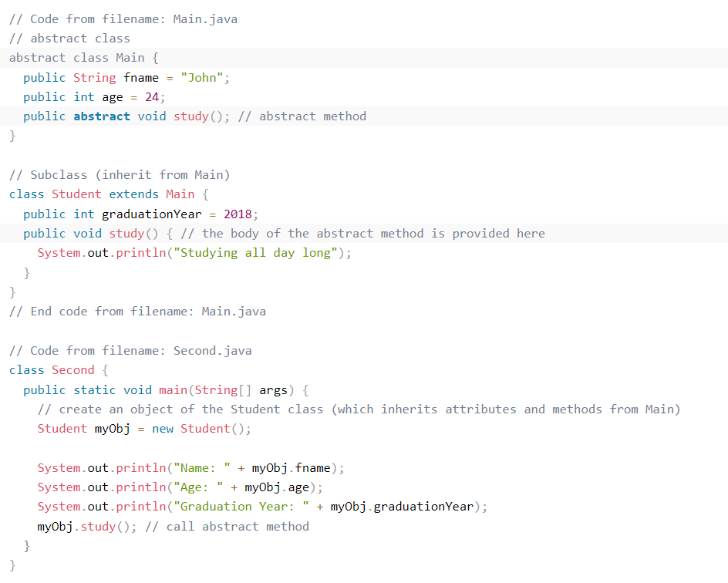

Slide 29
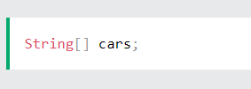
Java Arrays
Arrays are used to store multiple values in a single variable, instead of declaring separate variables for each value.
To declare an array, define the variable type with square brackets:
We have now declared a variable that holds an array of strings. To insert values to it, you can place the values in a comma-separated list, inside curly braces:
String[] cars = {"Volvo", "BMW", "Ford", "Mazda"};

Slide 30
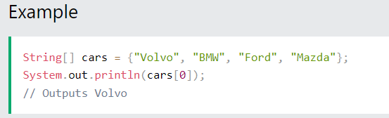
Access the Elements of an Array
You can access an array element by referring to the index number.
This statement accesses the value of the first element in cars:

Slide 31
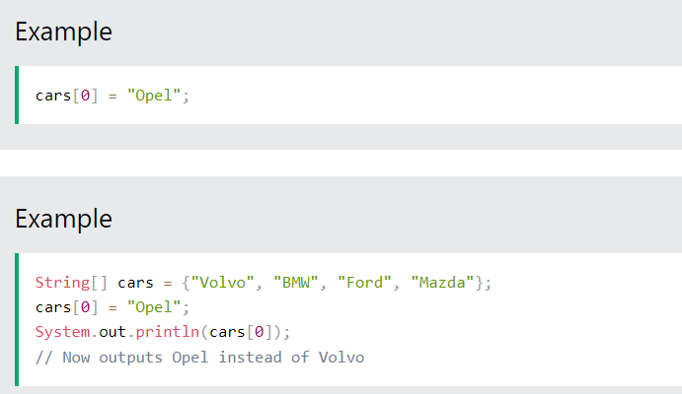
Change an Array Element
To change the value of a specific element, refer to the index number.

Slide 32
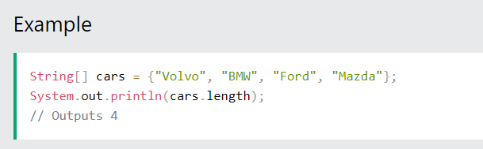
Array Length
To find out how many elements an array has, use the length property:

Slide 33
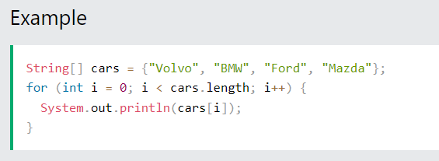
Loop Through an Array
You can loop through the array elements with the for loop, and use the length property to specify how many times the loop should run.
The following example outputs all elements in the cars array:

Slide 34
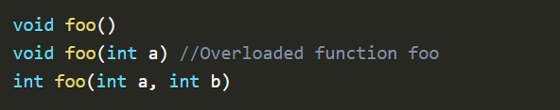
Method Overloading in Java
In Java, it is possible for a class to contain two or more methods with the same name but with different parameters. Such methods are called Overloaded methods.
Method overloading is used to increase the readability of the program.

Slide 35
Ways to perform method overloading :
In Java, method overloading can be performed by two ways listed below :
By changing the parameter type of the different methods
By changing the number of arguments accepted by the method
Now, let's have an example to understand the above ways of method overloading :

Slide 36
By changing the parameter type :
In the below example, we've created a class named calculate.
In the calculate class, we've two methods with the same name i.e. multiply
These two methods are overloaded because they have the same name but their return is different.
The return type of 1st method is int while the return type of the other method is double

Slide 37
Example
class calculate{
int multiply(int a,int b){
return a*b;
}
double multiply(double a,double b){
return a*b;
}
public static void main(String[] args) {
calculate obj = new calculate();
int c = obj.multiply(5,4);
double d = obj.multiply(5.1,4.2);
System.out.println("Mutiply method : returns integer : " + c);
System.out.println("Mutiply method : returns double : " + d);
}
}

Slide 38
By changing the number of arguments passed :
Again, we've created two methods with the same name i.e., multiply
The return type of both the methods is int.
But, the first method 2 arguments and the other method accepts 3 arguments

Slide 39
Example:
class calculate{
int multiply(int a,int b){
return a*b;
}
int multiply(int a,int b,int c){
return a*b*c;
}
public static void main(String[] args) {
calculate obj = new calculate();
int c = obj.multiply(5,4);
int d = obj.multiply(5,4,3);
System.out.println(c);
System.out.println(d);
}
}

Slide 40
Good Programming Practice
Some organizations require that every program begin with a comment that states the purpose of the program and the author, date and time when the program was last modified.
Use white space to enhance program readability.
A compilation error occurs if a public class’s filename is not exactly the same name as the class (in terms of both spelling and capitalization) followed by the .java extension.
By convention, every word in a class-name identifier begins with an uppercase letter. For example, the class-name identifier DollarAmount starts its first word, Dollar, with an uppercase D and its second word, Amount, with an uppercase A. This naming convention is known as camel case, because the uppercase letters stand out like a camel’s humps.
Indent the entire body of each class declaration one “level” between the braces that delimit the class’s. This format emphasizes the class declaration’s structure and makes it easier to read. We use three spaces to form a level of indent—many programmers prefer two or four spaces. Whatever you choose, use it consistently.

Slide 41
Good Programming Practice
IDEs typically indent code for you. The Tab key may also be used to indent code. You can configure each IDE to specify the number of spaces inserted when you press Tab.
It’s a syntax error if braces do not occur in matching pairs.
When you type an opening left brace, {, immediately type the closing right brace, }, then reposition the cursor between the braces and indent to begin typing the body. This practice helps prevent errors due to missing braces. Many IDEs do this for you.
Choosing meaningful variable names helps a program to be self-documenting (i.e., one can understand the program simply by reading it rather than by reading associated documentation or creating and viewing an excessive number of comments).
By convention, variable-name identifiers use the camel-case naming convention with a lowercase first letter—for example, firstNumber.

Slide 42
Practice Problem Sets
Problem 1: Write declarations, statements or comments that accomplish each of the following tasks:
State that a program will calculate the product of three integers.
Create a Scanner called input that reads values from the standard input.
Prompt the user to enter the first integer.
Read the first integer from the user and store it in the int variable x.
Prompt the user to enter the second integer.
Read the second integer from the user and store it in the int variable y.
Prompt the user to enter the third integer.
Read the third integer from the user and store it in the int variable z.
Compute the product of the three integers contained in variables x, y and z, and store the result in the int variable result.
Use System.out.printf to display the message "Product is" followed by the value of the variable result.

Slide 43
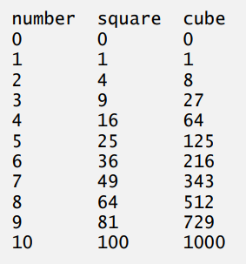
Practice Problem Set
Problem 2: Write an application that reads five integers and determines and prints the largest and smallest integers in the group.
Problem 3: Write an application that reads an integer and determines and prints whether it’s divisible by 3 or not.
Problem 4: Write an application that reads two integers, determines whether the first number tripled is a multiple of the second number doubled, and prints the result.
Problem 5: Using only the programming techniques you learned in this chapter, write an application that calculates the squares and cubes of the numbers from 0 to 10 and prints the resulting values in table format, as shown below.

Slide 44
Practice Problem Set
Problem 6: Write a program that inputs five numbers and determines and prints the number of negative numbers input, the number of positive numbers input and the number of zeros input

Slide 45
Resources:
https://www.w3schools.com
https://www.javatpoint.com/object-and-class-in-java
Chapter 2 Introduction to Java Applications
Chapter 3 Introduction to Java Applications

